Slide 1
NP-Completeness Reductions
CS240 Spring 2024
Rui Fan

Slide 2
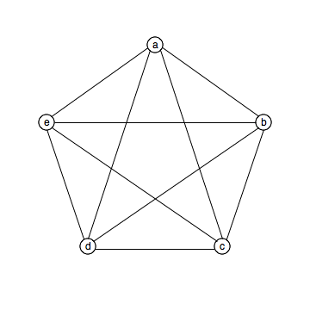
CLIQUE is NP-complete
CLIQUE Given a graph with n nodes, is there a clique with n/3 nodes?
I.e., are there n/3 nodes s.t. they’re all connected to each other?
Actually, the CLIQUE problem asks if there’s a k-clique, for an arbitrary k. But we consider k=n/3 for simplicity.
CLIQUE∈NP.
The witness is a purported n/3-clique.
The verifier just checks there are n/3 nodes, and they’re are all connected.

Slide 3
CLIQUE is NP-complete
Show some NP-complete problem reduces to CLIQUE.
The problem you reduce from has to be NP-complete, not just in NP.
Note, you’re reducing from the NPC problem to your problem, not the other way around.
You can choose any NP-complete problem to reduce from.
Decide on the right problem can make the task a lot easier. But this takes careful thought.

Slide 4
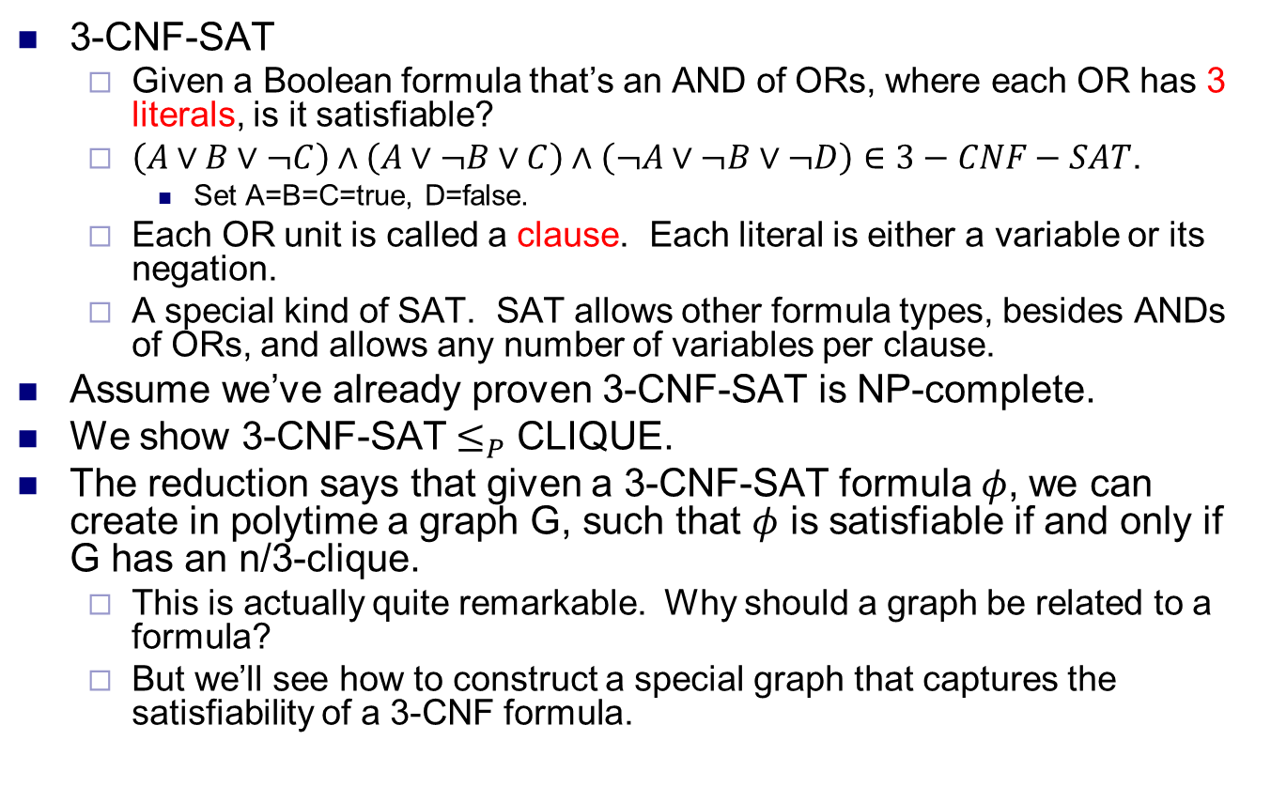
CLIQUE is NP-complete
3-CNF-SAT
Given a Boolean formula that’s an AND of ORs, where each OR has 3 literals, is it satisfiable?
$\left(A∨B∨¬C\right)∧\left(A∨¬B∨C\right)∧\left(¬A∨¬B∨¬D\right)∈3−CNF−SAT$.
Set A=B=C=true, D=false.
Each OR unit is called a clause. Each literal is either a variable or its negation.
A special kind of SAT. SAT allows other formula types, besides ANDs of ORs, and allows any number of variables per clause.
Assume we’ve already proven 3-CNF-SAT is NP-complete.
We show 3-CNF-SAT $≤_{P}$ CLIQUE.
The reduction says that given a 3-CNF-SAT formula $φ$, we can create in polytime a graph G, such that $φ$ is satisfiable if and only if G has an n/3-clique.
This is actually quite remarkable. Why should a graph be related to a formula?
But we’ll see how to construct a special graph that captures the satisfiability of a 3-CNF formula.

Slide 5
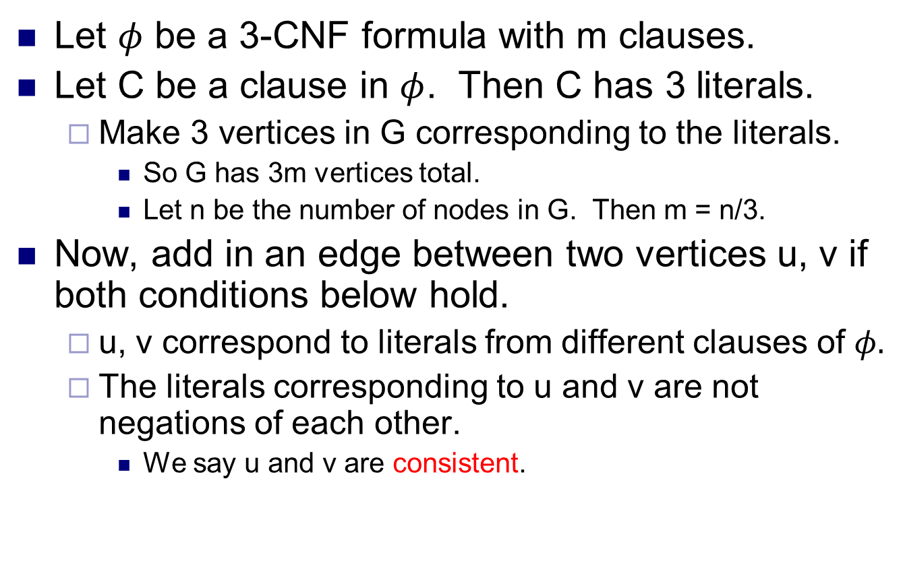
Reducing 3-CNF-SAT to CLIQUE
Let $φ$ be a 3-CNF formula with m clauses.
Let C be a clause in $φ$. Then C has 3 literals.
Make 3 vertices in G corresponding to the literals.
So G has 3m vertices total.
Let n be the number of nodes in G. Then m = n/3.
Now, add in an edge between two vertices u, v if both conditions below hold.
u, v correspond to literals from different clauses of $φ.$
The literals corresponding to u and v are not negations of each other.
We say u and v are consistent.

Slide 6
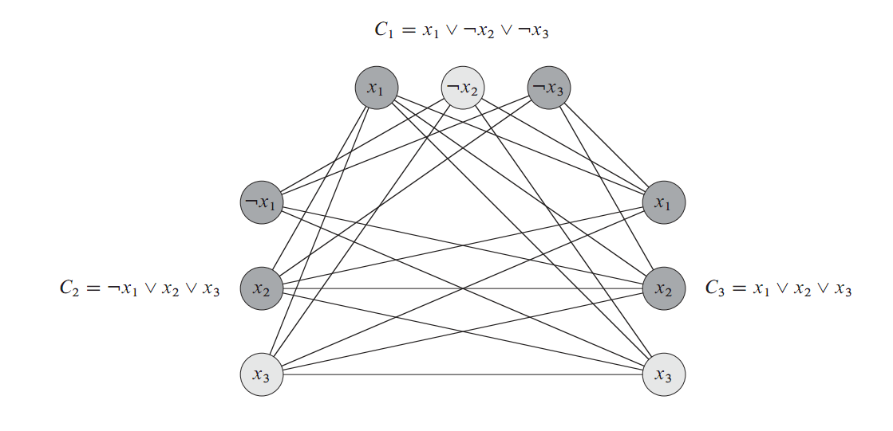
Reducing 3-CNF-SAT to CLIQUE
3 vertices for each clause.
For vertices u,v, add edge (u,v) if u,v are from different clauses, and are consistent (not negations of each other).
Source: Introduction to Algorithms, Cormen et al

Slide 7
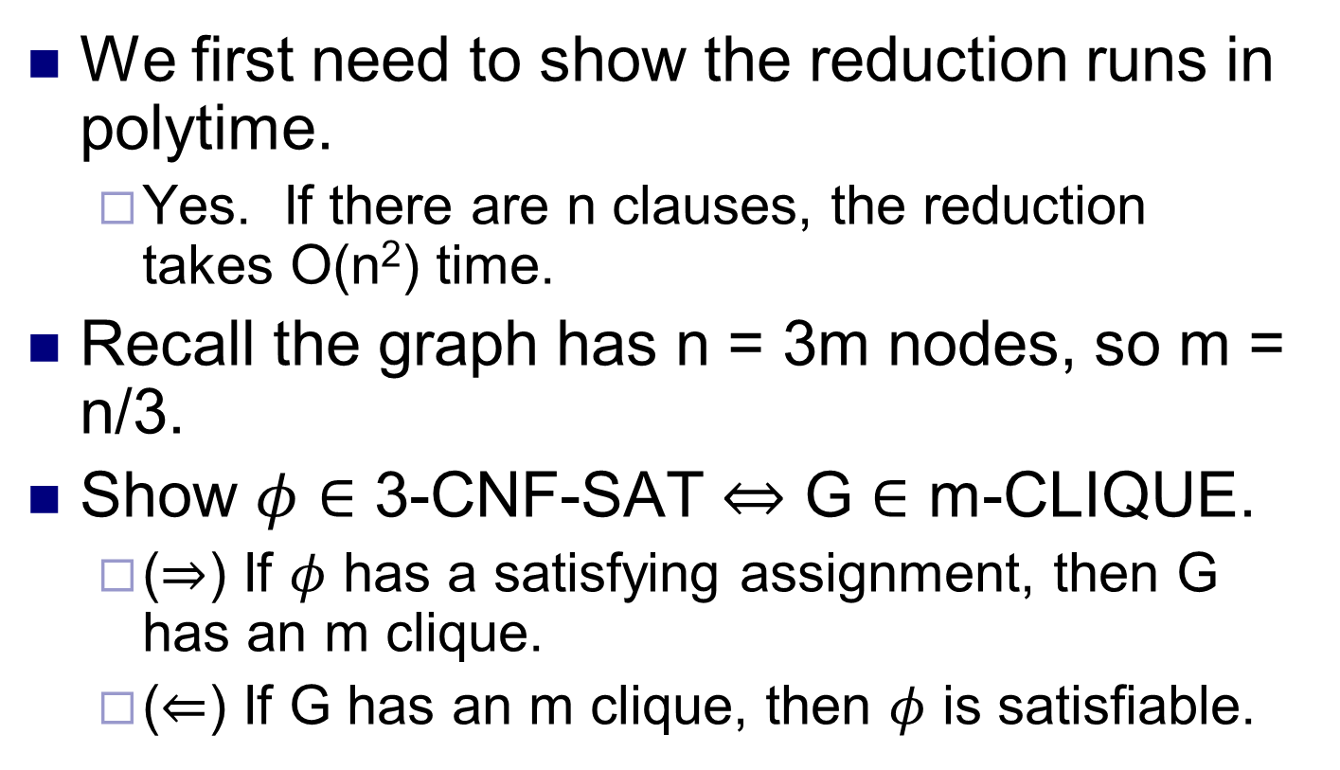
Proving the reduction works
We first need to show the reduction runs in polytime.
Yes. If there are n clauses, the reduction takes O(n²) time.
Recall the graph has n = 3m nodes, so m = n/3.
Show $φ∈$ 3-CNF-SAT $⇔$ G $∈$ m-CLIQUE.
($⇒$) If $φ$ has a satisfying assignment, then G has an m clique.
($⇐$) If G has an m clique, then $φ$ is satisfiable.

Slide 8
∃ sat. assignment ⇒ ∃ m clique
In the satisfying assignment, every clause has to be true, since we AND them.
In each clause, at least one literal has to be true, since we OR them.
So for each clause, pick a true literal.
We pick m = n/3 literals.
The true literal corresponds to a vertex in the graph.
Pick m vertices corresponding to the m literals we picked.
Claim The selected vertices form an m-clique.
Proof Consider any 2 vertices u, v we selected.
u,v come from different triples.
Because they come from literals from different clauses.

Slide 9
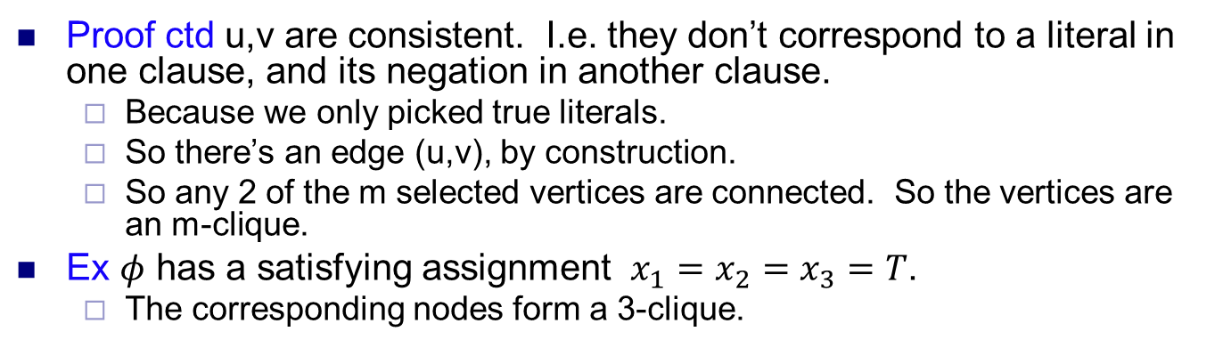
∃ sat. assignment ⇒ ∃ m clique
Proof ctd u,v are consistent. I.e. they don’t correspond to a literal in one clause, and its negation in another clause.
Because we only picked true literals.
So there’s an edge (u,v), by construction.
So any 2 of the m selected vertices are connected. So the vertices are an m-clique.
Ex $φ$ has a satisfying assignment $x_{1}=x_{2}=x_{3}=T$.
The corresponding nodes form a 3-clique.

Slide 10
∃ m clique ⇒ ∃ sat. assignment
Consider the m vertices in the clique.
None of the vertices come from literals in the same clause in φ.
For any pair of vertices, they’re connected.
There are no edges between vertices from the same clause.
None of the vertices correspond to a literal and its negation in φ.
We don’t add edges between such vertices.
For the literals corresponding to the clique vertices, set all of them to be true in the formula.
This is a valid assignment, since we never set a literal and its negation both to true.
We have one true literal per clause.
So every clause is true.
So the formula is true.

Slide 11
CLIQUE is NP-complete
We’ve shown CLIQUE∈NP.
We’ve shown 3-CNF-SAT ≤_{P} CLIQUE.
We found a polytime reduction, constructing a graph G s.t. for every 3-CNF-SAT formula φ
If φ is satisfiable, G has an n/3-clique.
If G has an n/3-clique, then φ is satisfiable.
So CLIQUE is NP-complete.

Slide 12
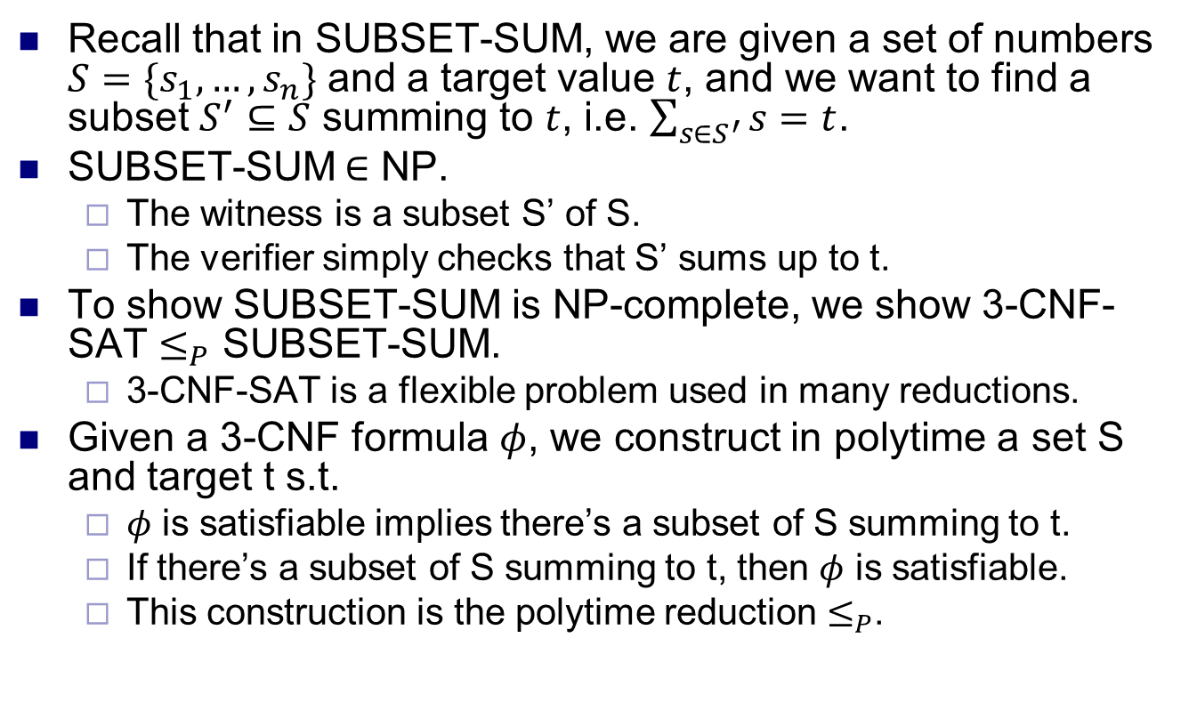
SUBSET-SUM is NP-complete
Recall that in SUBSET-SUM, we are given a set of numbers $S=\{s_{1}, …, s_{n}\}$ and a target value $t$, and we want to find a subset $S^{′}⊆S$ summing to $t$, i.e. $\sum_{s∈S^{′}}{s}=t$.
SUBSET-SUM$∈$ NP.
The witness is a subset S’ of S.
The verifier simply checks that S’ sums up to t.
To show SUBSET-SUM is NP-complete, we show 3-CNF-SAT $≤_{P}$ SUBSET-SUM.
3-CNF-SAT is a flexible problem used in many reductions.
Given a 3-CNF formula $φ$, we construct in polytime a set S and target t s.t.
$φ$ is satisfiable implies there’s a subset of S summing to t.
If there’s a subset of S summing to t, then $φ$ is satisfiable.
This construction is the polytime reduction $≤_{P}$.

Slide 13
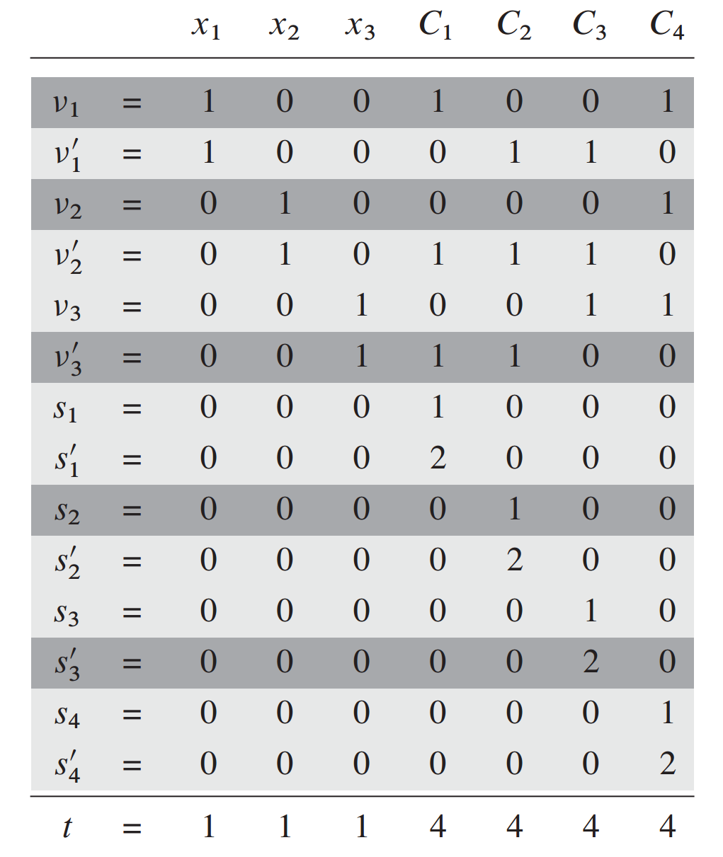
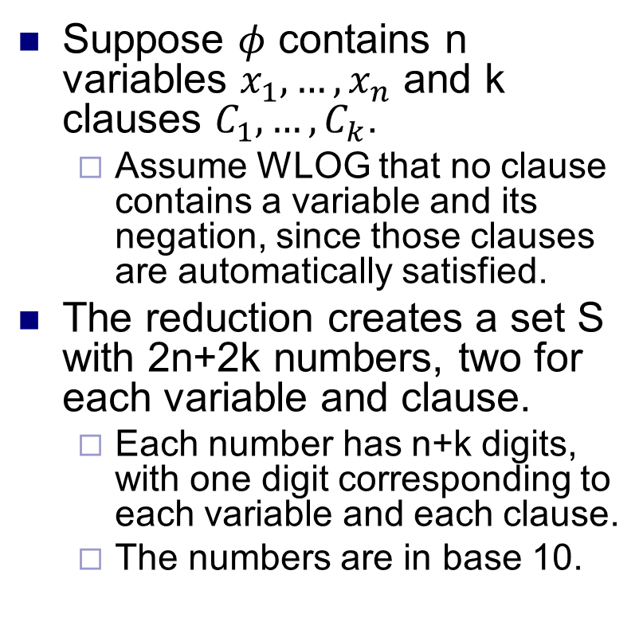
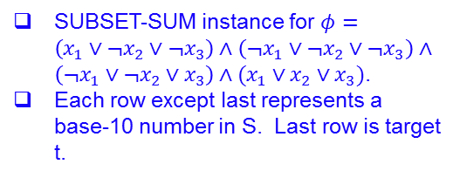
The reduction
Suppose $φ$ contains n variables $x_{1},…, x_{n}$ and k clauses $C_{1},…,C_{k}$.
Assume WLOG that no clause contains a variable and its negation, since those clauses are automatically satisfied.
The reduction creates a set S with 2n+2k numbers, two for each variable and clause.
Each number has n+k digits, with one digit corresponding to each variable and each clause.
The numbers are in base 10.
SUBSET-SUM instance for $φ=\left(x_{1}∨¬x_{2}∨¬x_{3}\right)∧\left(¬x_{1}∨¬x_{2}∨¬x_{3}\right)∧\left(¬x_{1}∨¬x_{2}∨x_{3}\right)∧(x_{1}∨x_{2}∨x_{3})$.
Each row except last represents a base-10 number in S. Last row is target t.

Slide 14
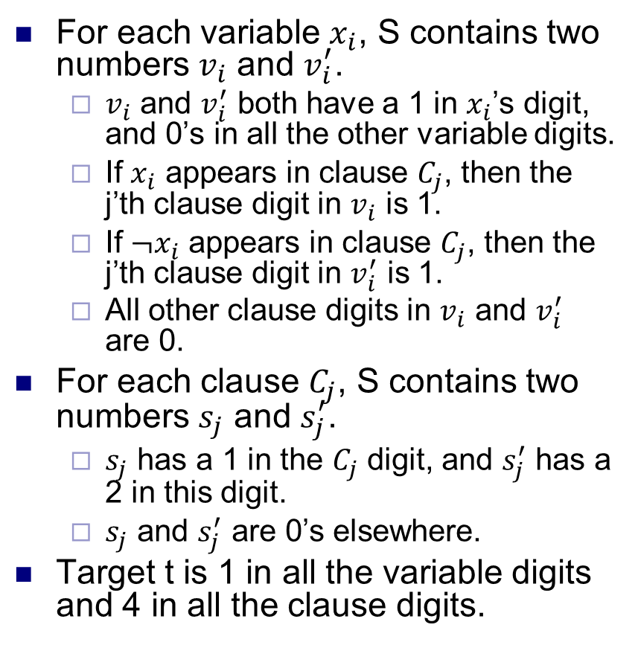
The reduction
For each variable $x_{i}$, S contains two numbers $v_{i}$ and $v_{i}^{′}$.
$v_{i}$ and $v_{i}^{′}$ both have a 1 in $x_{i}$’s digit, and 0’s in all the other variable digits.
If $x_{i}$ appears in clause $C_{j}$, then the j’th clause digit in $v_{i}$ is 1.
If $¬x_{i}$ appears in clause $C_{j}$, then the j’th clause digit in $v_{i}^{′}$ is 1.
All other clause digits in $v_{i}$ and $v_{i}^{′}$ are 0.
For each clause $C_{j}$, S contains two numbers $s_{j}$ and $s_{j}^{′}$.
$s_{j}$ has a 1 in the $C_{j}$ digit, and $s_{j}^{′}$ has a 2 in this digit.
$s_{j}$ and $s_{j}^{′}$ are 0’s elsewhere.
Target t is 1 in all the variable digits and 4 in all the clause digits.
SUBSET-SUM instance for $φ=\left(x_{1}∨¬x_{2}∨¬x_{3}\right)∧\left(¬x_{1}∨¬x_{2}∨¬x_{3}\right)∧\left(¬x_{1}∨¬x_{2}∨x_{3}\right)∧(x_{1}∨x_{2}∨x_{3})$.
Each row except last represents a base-10 number in S. Last row is target t.

Slide 15
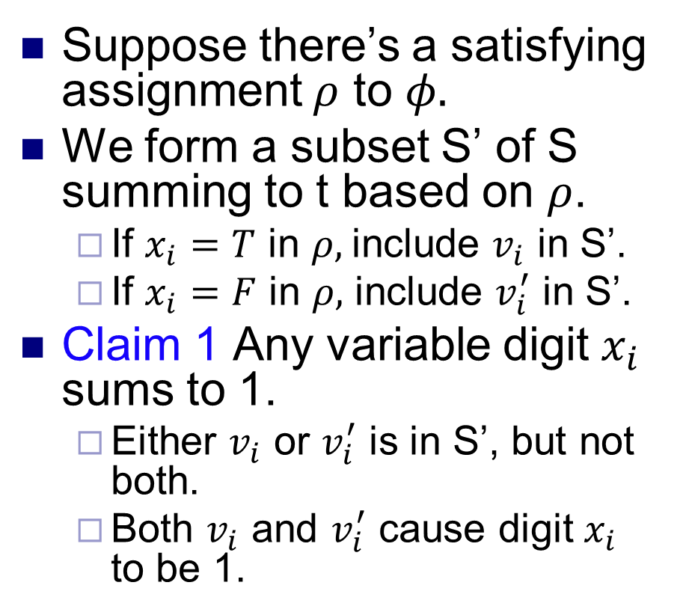
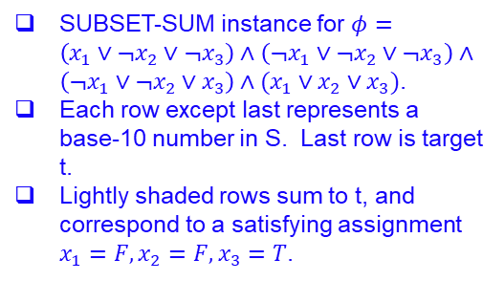
$$φ∈3\text{−}CNF\text{−}SAT⇒\left(S,t\right)∈SUBSET\text{−}SUM$$
Suppose there’s a satisfying assignment $ρ$ to $φ.$
We form a subset S’ of S summing to t based on $ρ$.
If $x_{i}=T$ in $ρ,$include $v_{i}$ in S’.
If $x_{i}=F$ in $ρ,$ include $v_{i}^{′}$ in S’.
Claim 1 Any variable digit $x_{i}$ sums to 1.
Either $v_{i}$ or $v_{i}^{′}$ is in S’, but not both.
Both $v_{i}$ and $v_{i}^{′}$ cause digit $x_{i}$ to be 1.
SUBSET-SUM instance for $φ=\left(x_{1}∨¬x_{2}∨¬x_{3}\right)∧\left(¬x_{1}∨¬x_{2}∨¬x_{3}\right)∧\left(¬x_{1}∨¬x_{2}∨x_{3}\right)∧(x_{1}∨x_{2}∨x_{3})$.
Each row except last represents a base-10 number in S. Last row is target t.
Lightly shaded rows sum to t, and correspond to a satisfying assignment $x_{1}=F, x_{2}=F, x_{3}=T$.

Slide 16
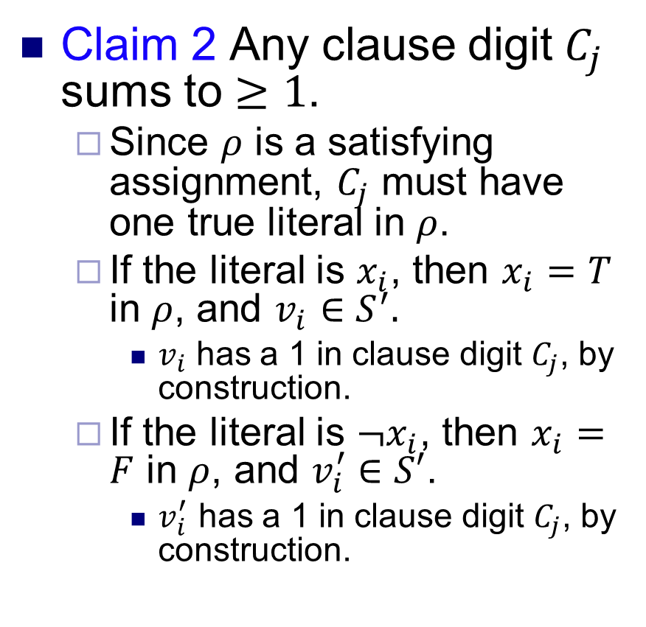
$$φ∈3\text{−}CNF\text{−}SAT⇒\left(S,t\right)∈SUBSET\text{−}SUM$$
Claim 2 Any clause digit $C_{j}$ sums to $≥1$.
Since $ρ$ is a satisfying assignment, $C_{j}$ must have one true literal in $ρ$.
If the literal is $x_{i}$, then $x_{i}=T$ in $ρ$, and $v_{i}∈S^{′}.$
$v_{i}$ has a 1 in clause digit $C_{j}$, by construction.
If the literal is $¬x_{i}$, then $x_{i}=F$ in $ρ$, and $v_{i}^{′}∈S′$.
$v_{i}^{′}$ has a 1 in clause digit $C_{j}$, by construction.
SUBSET-SUM instance for $φ=\left(x_{1}∨¬x_{2}∨¬x_{3}\right)∧\left(¬x_{1}∨¬x_{2}∨¬x_{3}\right)∧\left(¬x_{1}∨¬x_{2}∨x_{3}\right)∧(x_{1}∨x_{2}∨x_{3})$.
Each row except last represents a base-10 number in S. Last row is target t.
Lightly shaded rows sum to t, and correspond to a satisfying assignment $x_{1}=F, x_{2}=F, x_{3}=T$.

Slide 17
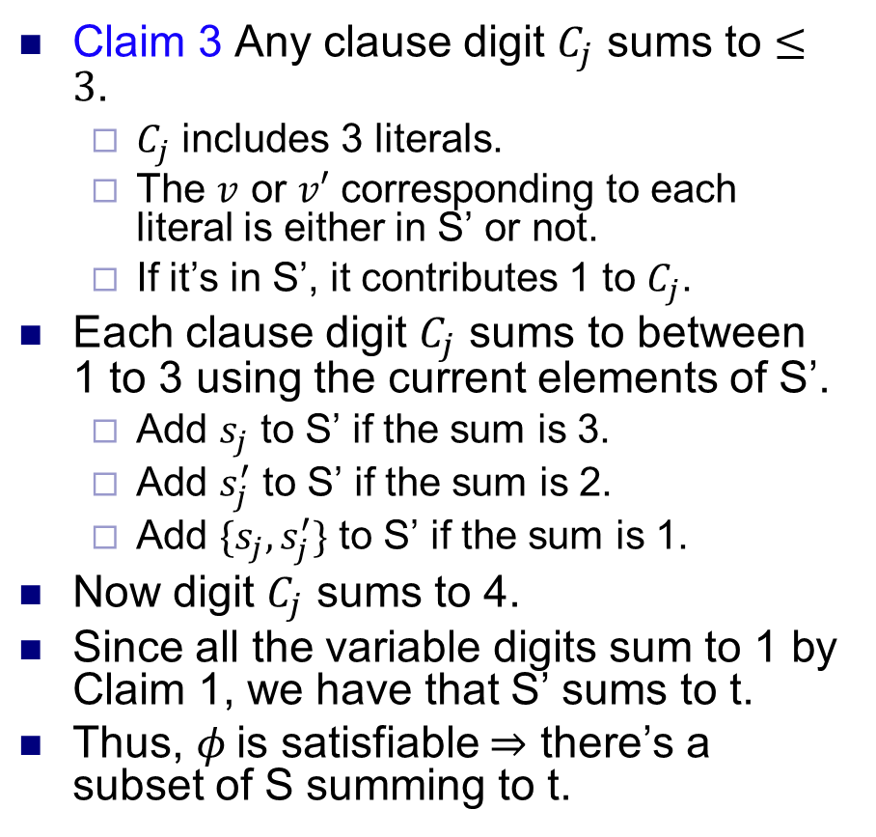
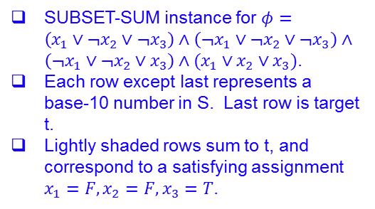
$$φ∈3\text{−}CNF\text{−}SAT⇒\left(S,t\right)∈SUBSET\text{−}SUM$$
Claim 3 Any clause digit $C_{j}$ sums to $≤3$.
$C_{j}$ includes 3 literals.
The $v$ or $v′$ corresponding to each literal is either in S’ or not.
If it’s in S’, it contributes 1 to $C_{j}$.
Each clause digit $C_{j}$ sums to between 1 to 3 using the current elements of S’.
Add $s_{j}$ to S’ if the sum is 3.
Add $s_{j}^{′}$ to S’ if the sum is 2.
Add $\{s_{j}, s_{j}^{′}\}$ to S’ if the sum is 1.
Now digit $C_{j}$ sums to 4.
Since all the variable digits sum to 1 by Claim 1, we have that S’ sums to t.
Thus, $φ$ is satisfiable $⇒$ there’s a subset of S summing to t.
SUBSET-SUM instance for $φ=\left(x_{1}∨¬x_{2}∨¬x_{3}\right)∧\left(¬x_{1}∨¬x_{2}∨¬x_{3}\right)∧\left(¬x_{1}∨¬x_{2}∨x_{3}\right)∧(x_{1}∨x_{2}∨x_{3})$.
Each row except last represents a base-10 number in S. Last row is target t.
Lightly shaded rows sum to t, and correspond to a satisfying assignment $x_{1}=F, x_{2}=F, x_{3}=T$.

Slide 18
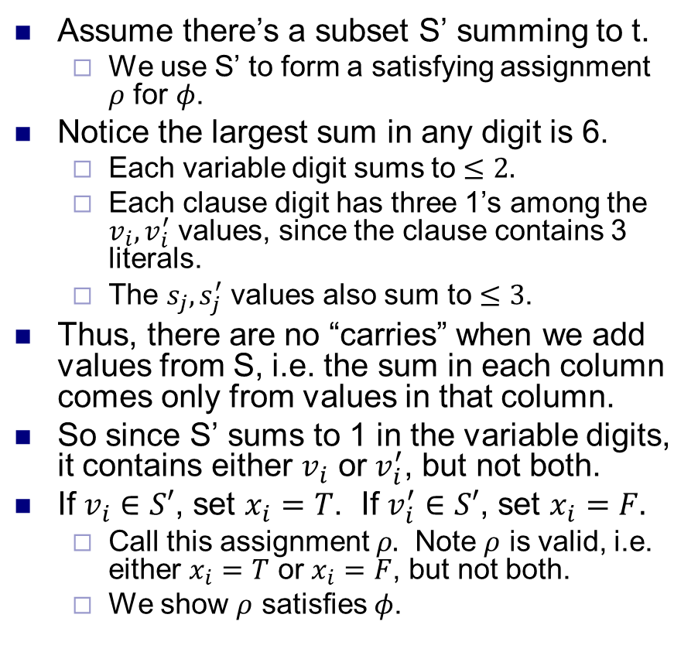
$$\left(S,t\right)∈SUBSET\text{−}SUM⇒φ∈3\text{−}CNF\text{−}SAT$$
Assume there’s a subset S’ summing to t.
We use S’ to form a satisfying assignment $ρ$ for $φ$.
Notice the largest sum in any digit is 6.
Each variable digit sums to $≤2.$
Each clause digit has three 1’s among the $v_{i}, v_{i}^{′}$ values, since the clause contains 3 literals.
The $s_{j}, s_{j}^{′}$ values also sum to $≤3$.
Thus, there are no “carries” when we add values from S, i.e. the sum in each column comes only from values in that column.
So since S’ sums to 1 in the variable digits, it contains either $v_{i}$ or $v_{i}^{′}$, but not both.
If $v_{i}∈S′$, set $x_{i}=T$. If $v_{i}^{′}∈S′$, set $x_{i}=F.$
Call this assignment $ρ.$ Note $ρ$ is valid, i.e. either $x_{i}=T$ or $x_{i}=F$, but not both.
We show $ρ$ satisfies $φ$.
SUBSET-SUM instance for $φ=\left(x_{1}∨¬x_{2}∨¬x_{3}\right)∧\left(¬x_{1}∨¬x_{2}∨¬x_{3}\right)∧\left(¬x_{1}∨¬x_{2}∨x_{3}\right)∧(x_{1}∨x_{2}∨x_{3})$.
Each row except last represents a base-10 number in S. Last row is target t.
Lightly shaded rows sum to t, and correspond to a satisfying assignment $x_{1}=F, x_{2}=F, x_{3}=T$.

Slide 19
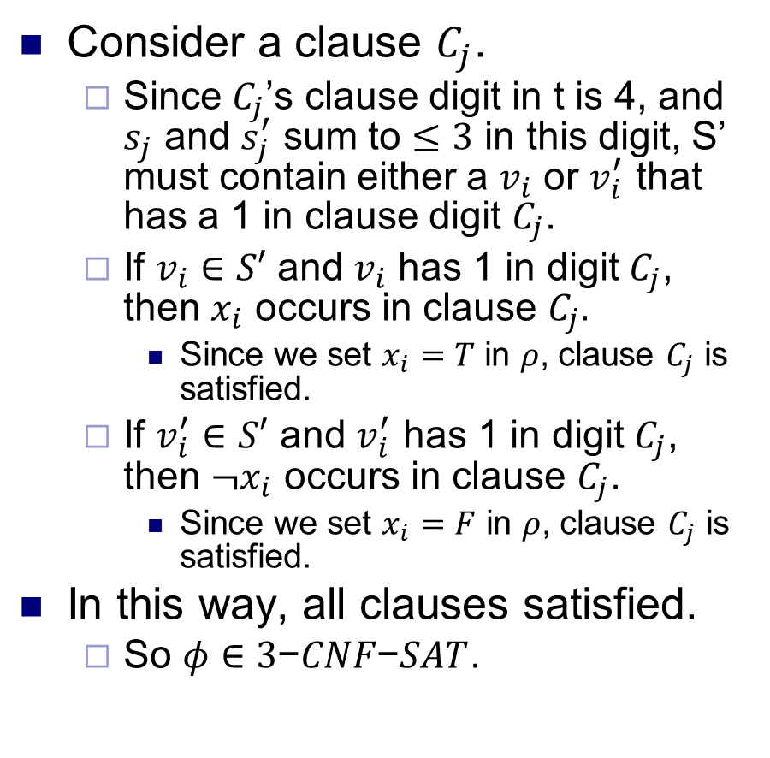
$$\left(S,t\right)∈SUBSET\text{−}SUM⇒φ∈3\text{−}CNF\text{−}SAT$$
Consider a clause $C_{j}$.
Since $C_{j}$’s clause digit in t is 4, and $s_{j}$ and $s_{j}^{′}$ sum to $≤3$ in this digit, S’ must contain either a $v_{i}$ or $v_{i}^{′}$ that has a 1 in clause digit $C_{j}$.
If $v_{i}∈S′$ and $v_{i}$ has 1 in digit $C_{j}$, then $x_{i}$ occurs in clause $C_{j}.$
Since we set $x_{i}=T$ in $ρ$, clause $C_{j}$ is satisfied.
If $v_{i}^{′}∈S′$ and $v_{i}^{′}$ has 1 in digit $C_{j}$, then $¬x_{i}$ occurs in clause $C_{j}$.
Since we set $x_{i}=F$ in $ρ$, clause $C_{j}$ is satisfied.
In this way, all clauses satisfied.
So $φ∈3\text{−}CNF\text{−}SAT$.
SUBSET-SUM instance for $φ=\left(x_{1}∨¬x_{2}∨¬x_{3}\right)∧\left(¬x_{1}∨¬x_{2}∨¬x_{3}\right)∧\left(¬x_{1}∨¬x_{2}∨x_{3}\right)∧(x_{1}∨x_{2}∨x_{3})$.
Each row except last represents a base-10 number in S. Last row is target t.
Lightly shaded rows sum to t, and correspond to a satisfying assignment $x_{1}=F, x_{2}=F, x_{3}=T$.

Slide 20
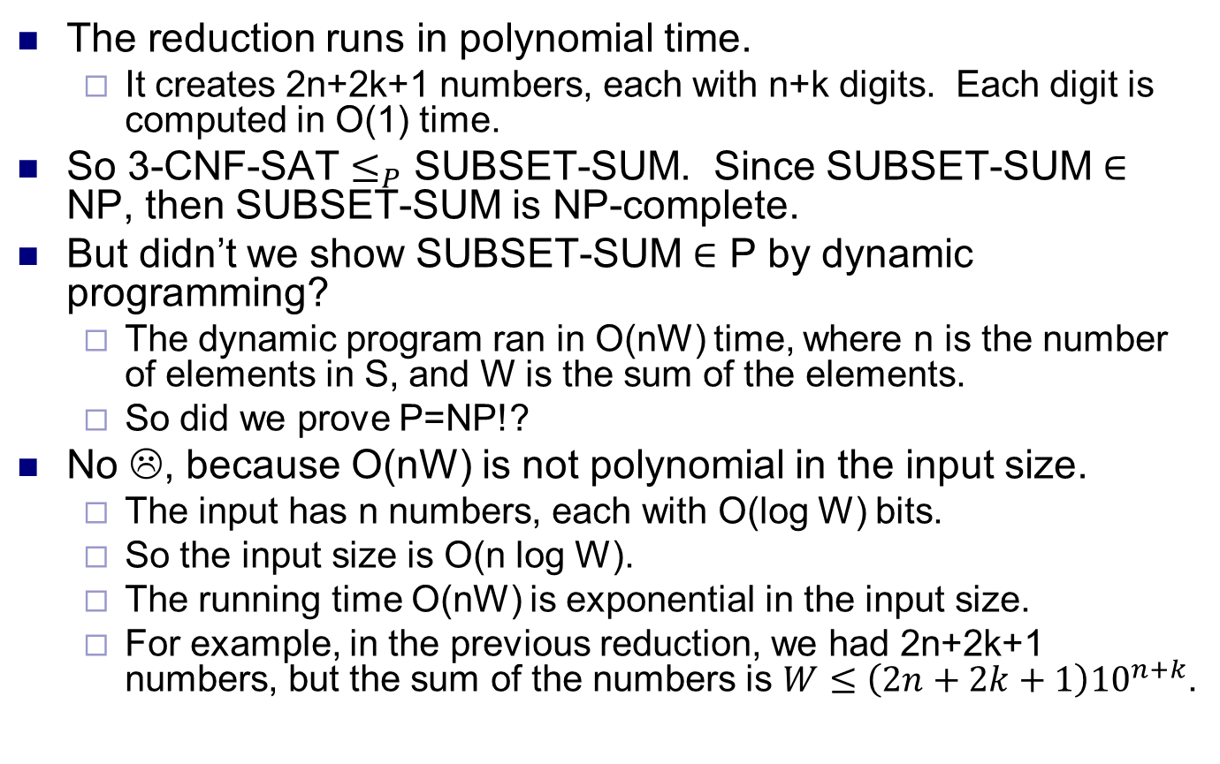
SUBSET-SUM is NP-complete
The reduction runs in polynomial time.
It creates 2n+2k+1 numbers, each with n+k digits. Each digit is computed in O(1) time.
So 3-CNF-SAT $≤_{P}$ SUBSET-SUM. Since SUBSET-SUM $∈$ NP, then SUBSET-SUM is NP-complete.
But didn’t we show SUBSET-SUM $∈$ P by dynamic programming?
The dynamic program ran in O(nW) time, where n is the number of elements in S, and W is the sum of the elements.
So did we prove P=NP!?
No ☹, because O(nW) is not polynomial in the input size.
The input has n numbers, each with O(log W) bits.
So the input size is O(n log W).
The running time O(nW) is exponential in the input size.
For example, in the previous reduction, we had 2n+2k+1 numbers, but the sum of the numbers is $W≤\left(2n+2k+1\right){10}^{n+k}$.

Slide 21
Hamiltonian Cycle
HAM-CYCLE: given an undirected graph G = (V, E), does there exist a simple cycle Γ that contains every node in V.
YES: vertices and faces of a dodecahedron.

Slide 22
Hamiltonian Cycle
HAM-CYCLE: given an undirected graph G = (V, E), does there exist a simple cycle Γ that contains every node in V.
1
1'
2
2'
3
3'
4
4'
5
NO: bipartite graph with odd number of nodes.

Slide 23
3-SAT Reduces to Directed Hamiltonian Cycle
Claim. 3-SAT ≤ _{P} DIR-HAM-CYCLE.
Pf. Given an instance Φ of 3-SAT, we construct an instance of DIR-HAM-CYCLE that has a Hamiltonian cycle iff Φ is satisfiable.

Slide 24
3-SAT Reduces to Directed Hamiltonian Cycle
Construction. Given 3-SAT instance Φ with n variables x_{i} and k clauses.
Construct G to have 2^{n} Hamiltonian cycles.
Intuition: traverse path i from left to right ⇔ set variable x_{i} = 1.
s
x₁
x₂
x₃
t
3k + 3
Notes:
the bi-directed edge represents two anti-parallel directed edges

Slide 25
3-SAT Reduces to Directed Hamiltonian Cycle
Construction. Given 3-SAT instance Φ with n variables x_{i} and k clauses.
For each clause: add a node and 6 edges.
clause node
clause node
s
x₁
x₂
x₃
t
Notes:
Explaining why 3k+3: see the last paragraph of textbook p.477
If 2k+2: We may go left-to-right in x2 and go up to C1, then go down to x3 and go left-to-right and up to C2, then go down to x2 and continue to the right. Those unvisited nodes in x3 might be visited if we have more clauses and repeat similar routes, and it becomes complicated to rule out such possibilities.

Slide 26
3-SAT Reduces to Directed Hamiltonian Cycle
Claim. Φ is satisfiable iff G has a Hamiltonian cycle.
Pf. ⇒
Suppose 3-SAT instance has satisfying assignment x*.
Then, define Hamiltonian cycle in G as follows:
if x*_{i} = 1, traverse row i from left to right
if x*_{i} = 0, traverse row i from right to left
for each clause C_{j} , there will be at least one row i in which we are going in "correct" direction to splice node C_{j} into tour

Slide 27
3-SAT Reduces to Directed Hamiltonian Cycle
Claim. Φ is satisfiable iff G has a Hamiltonian cycle.
Pf. ⇐
Suppose G has a Hamiltonian cycle Γ.
If Γ enters clause node C_{j} , it must depart on mate edge.
thus, nodes immediately before and after C_{j} are connected by an edge e in G
removing C_{j} from cycle, and replacing it with edge e yields Hamiltonian cycle on G - { C_{j} }
Continuing in this way, we are left with Hamiltonian cycle Γ' in G - { C₁ , C₂ , . . . , C_{k} }.
Set x*_{i} = 1 iff Γ' traverses row i left to right.
Since Γ visits each clause node C_{j} , at least one of the paths is traversed in "correct" direction, and each clause is satisfied. ▪

Slide 28
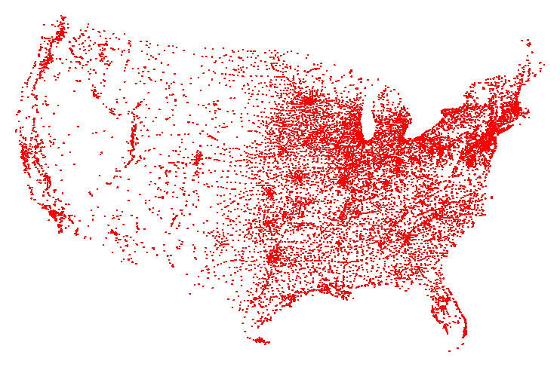
Traveling Salesperson Problem
TSP. Given a set of n cities and a pairwise distance function d(u, v), is there a tour of length ≤ D?
All 13,509 cities in US with a population of at least 500 Reference: http://www.tsp.gatech.edu
Notes:
Tour = cycle

Slide 29
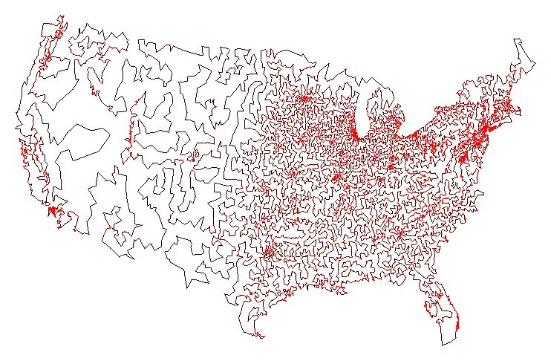
Traveling Salesperson Problem
TSP. Given a set of n cities and a pairwise distance function d(u, v), is there a tour of length ≤ D?
Optimal TSP tour
Reference: http://www.tsp.gatech.edu

Slide 30
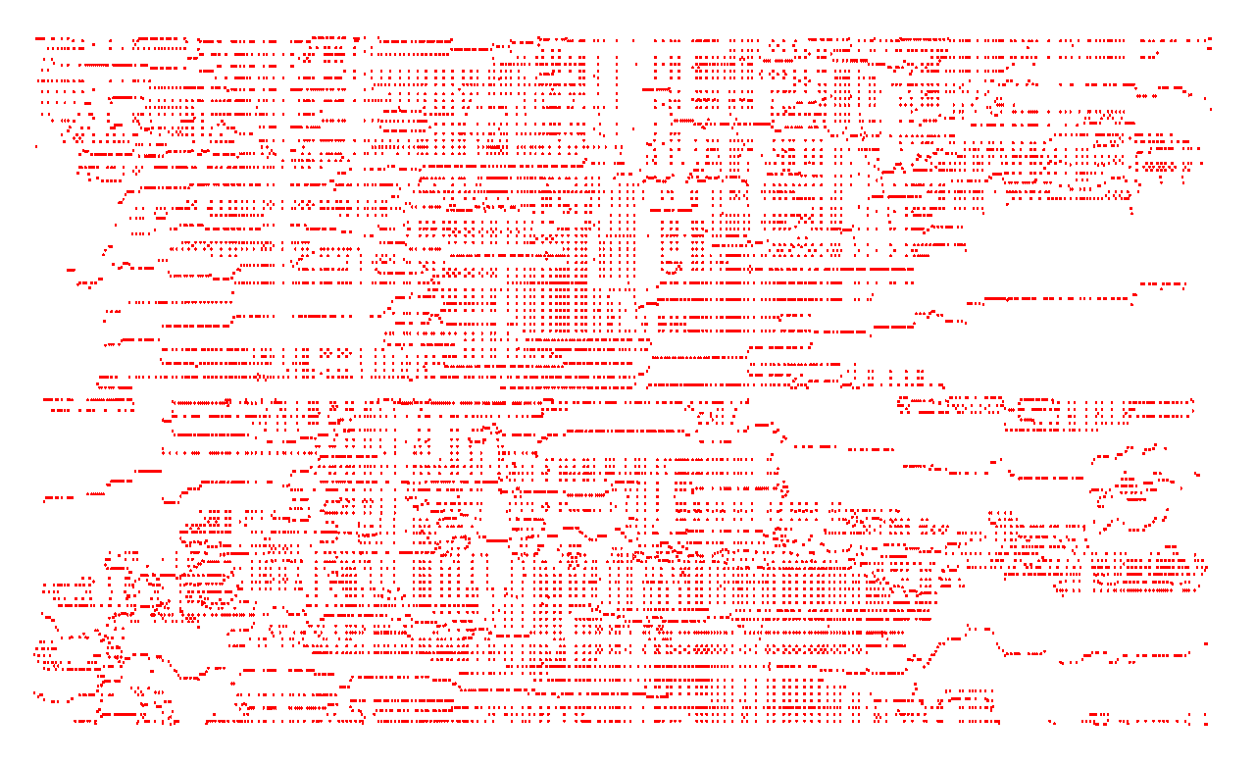
Traveling Salesperson Problem
TSP. Given a set of n cities and a pairwise distance function d(u, v), is there a tour of length ≤ D?
11,849 holes to drill in a programmed logic array
Reference: http://www.tsp.gatech.edu

Slide 31
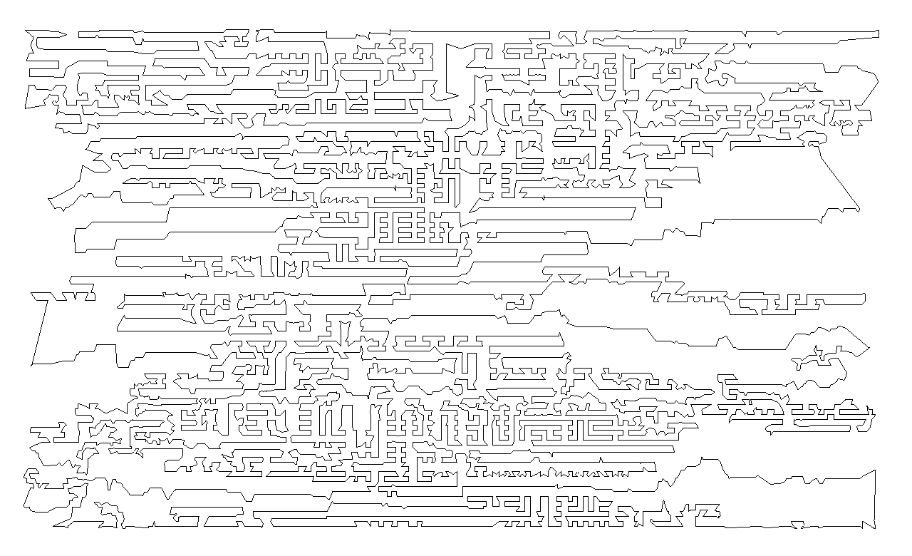
Traveling Salesperson Problem
TSP. Given a set of n cities and a pairwise distance function d(u, v), is there a tour of length ≤ D?
Optimal TSP tour
Reference: http://www.tsp.gatech.edu

Slide 32
Traveling Salesperson Problem
TSP. Given a set of n cities and a pairwise distance function d(u, v), is there a tour of length ≤ D?
HAM-CYCLE: given a graph G = (V, E), does there exists a simple cycle that contains every node in V?
Claim. HAM-CYCLE ≤ _{P} TSP.
Pf.
Given instance G = (V, E) of HAM-CYCLE, create n cities with distance function
TSP instance has tour of length ≤ n iff G is Hamiltonian. ▪
Notes:
Remark. TSP instance in reduction satisfies triangle inequality.

